Slide 1
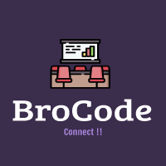



Automated Meeting
Room Booking System
Team Name:-
Bro-Code
Team Members:
Ankit
Atharva
Kirti
Lavanya
Naina
Priyanka
Roopa
Sarthak

Slide 2

Automated Meeting Room Booking System
Meeting room booking systems provide simple tools for reserving conference rooms and other spaces or resources within an office or shared workplace. This software ensures that organizers and attendees have the necessary accommodations for important meetings, and at the same time, office managers maintain an accurate, up-to-date view of how company resources are being utilized.

Slide 3

To qualify for inclusion in the Meeting Room Booking Systems category, a product must:
Provide an overview of company conference rooms, along with scheduled meeting times and details
Allow users with the appropriate permissions to book available meeting rooms, modify event details, and invite attendees
Equip administrators, such as office managers, with tools to modify user permissions, room and resource details, and specific meeting information
Sync with organizer and attendee calendar and/or email tools

Slide 4
Users
ADMIN
Creates and configures meeting rooms
MANAGERS
Search and books a room for a meeting
Members
Part of a meeting
Automated Meeting Room Booking System consists of three types of Users !

Slide 5
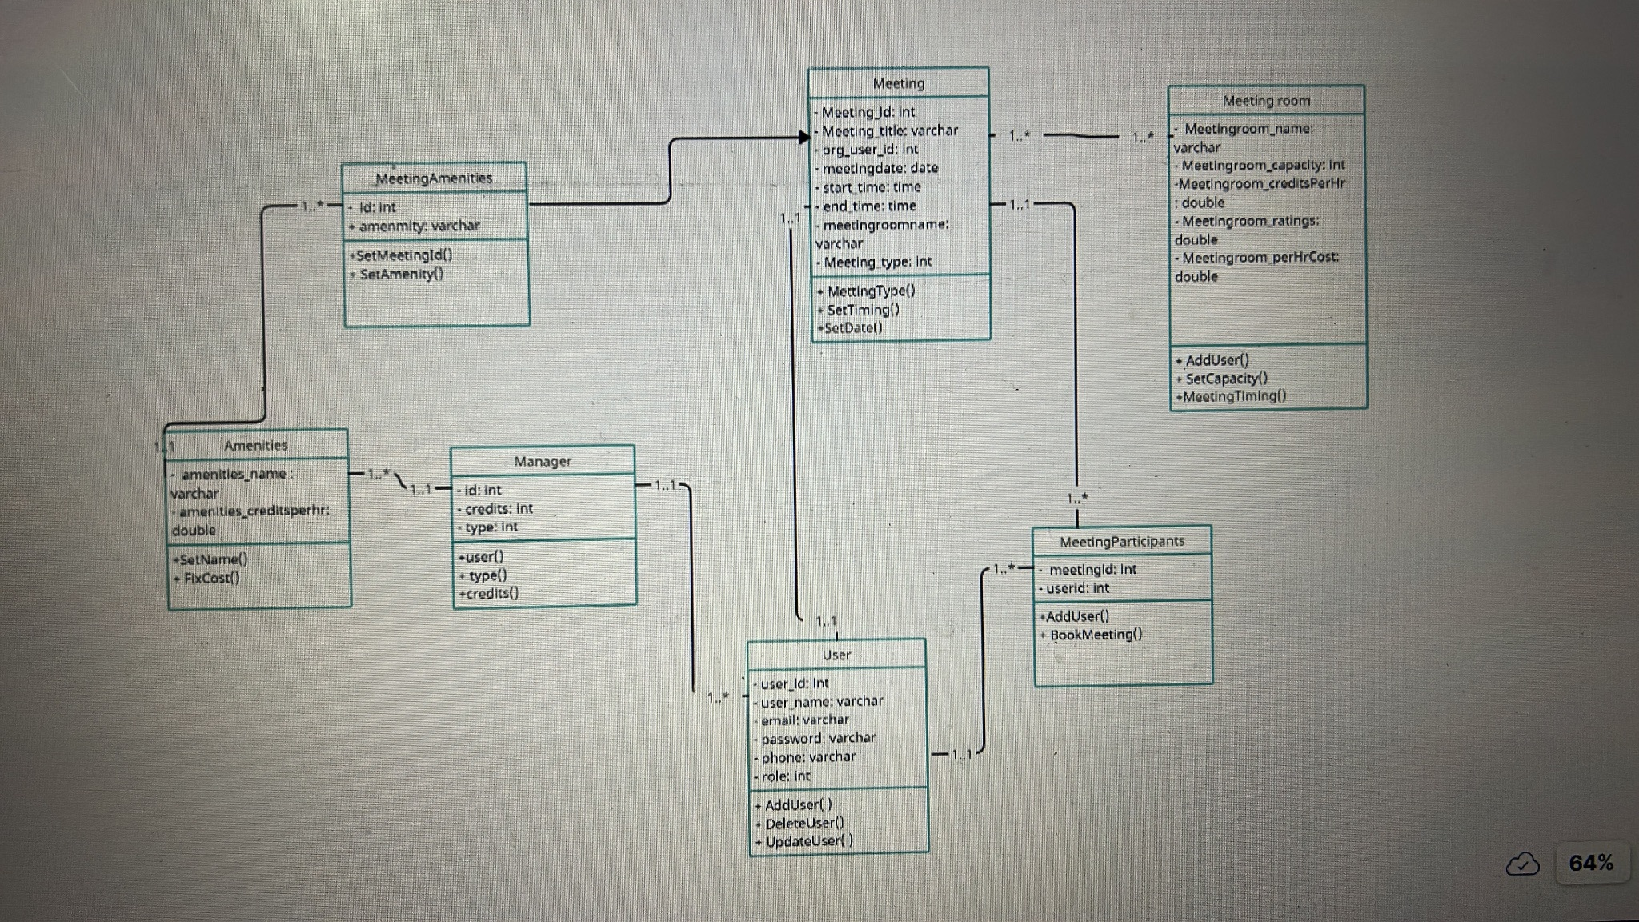
Class Diagram

Slide 6
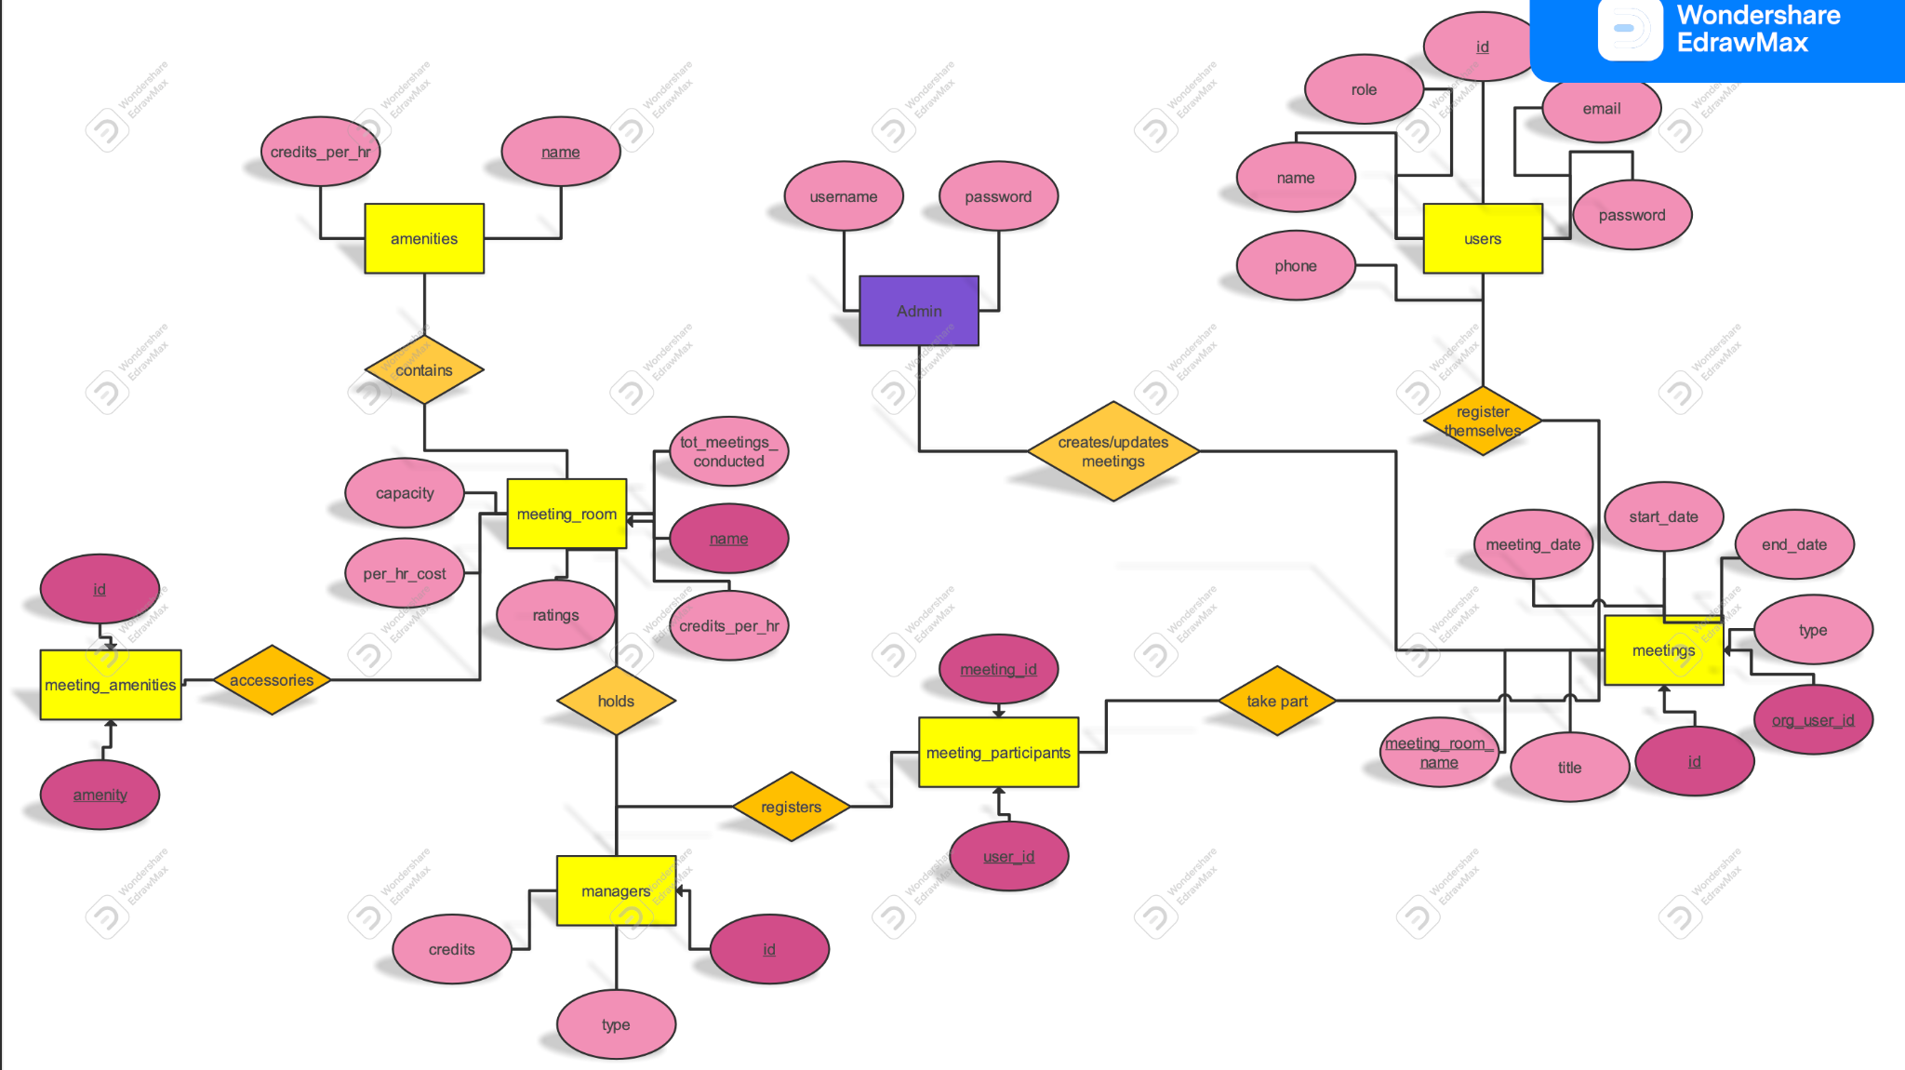
ER Diagram
Tip
In this example, we’re leading off with something unexpected.
While the audience is trying to come up with a number, we’ll surprise them with the next slide.

Slide 7
Features:
Logging
Used SLF4J for loose coupling with Log4j.
Logs at different priority levels and writes to a log file.
Automatic Credits Refill
Implemented using Java’s scheduled executor service.
Executes Every Monday.
Exception Handling
Individual Exceptions for each layer.
DAO exception rethrown in service to make more business sense.

Slide 8
Features:
Layered Architecture
Created DAO and Service Layers to separate Data Access and Business Logic.
Reading Users From XML
Reading XML at front end using DOM Parser
Using Properties FIle
Using an external properties file to write all sql Statements.
SQL queries can be modified without recompiling project.
Properties file used using java.util.Properties.

Slide 9
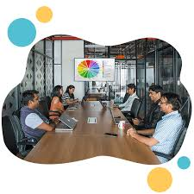
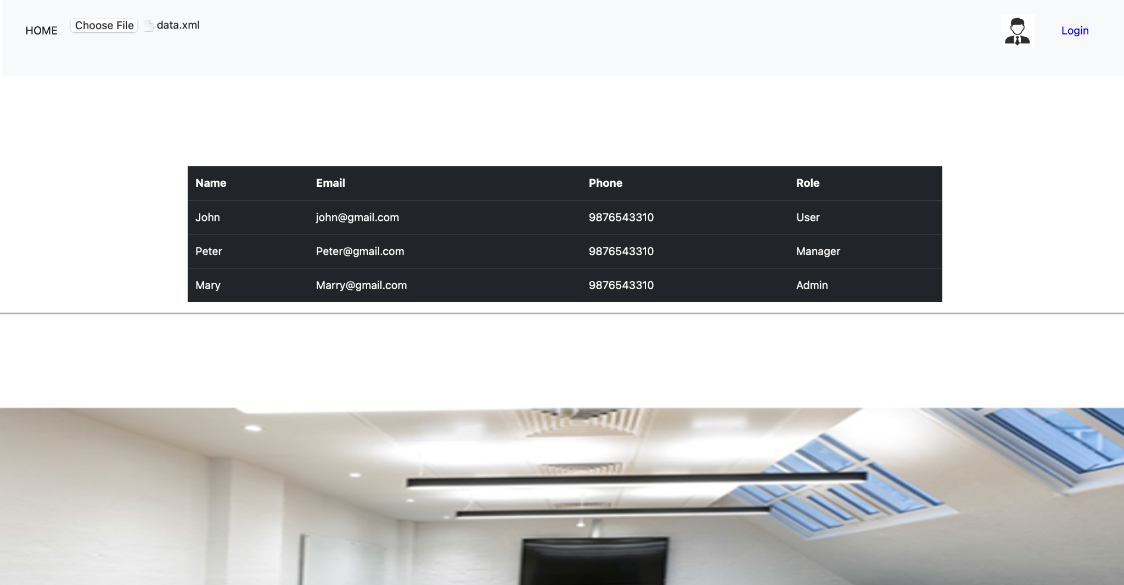
UI
Tip
Don’t wait till the end of the presentation to give the bottom line.
Reveal your product or idea (in this case a translation app) up front.

Slide 10
2. Examples
By the end of this section, your audience should be able to visualize:
Robust and Secure
Who Show them a specific person who would benefit from your solution.

Slide 11
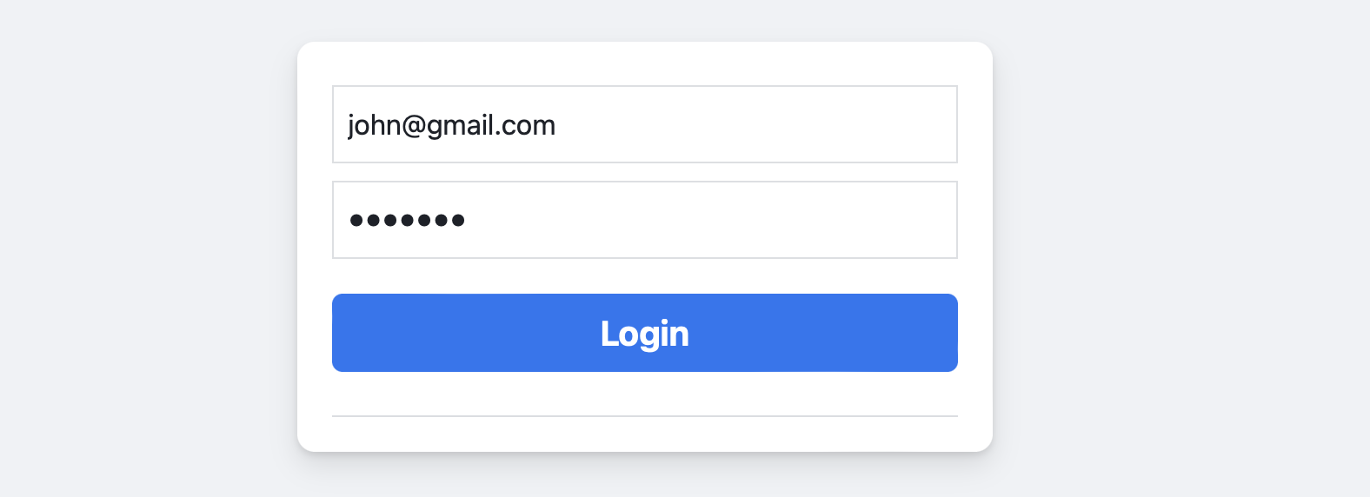
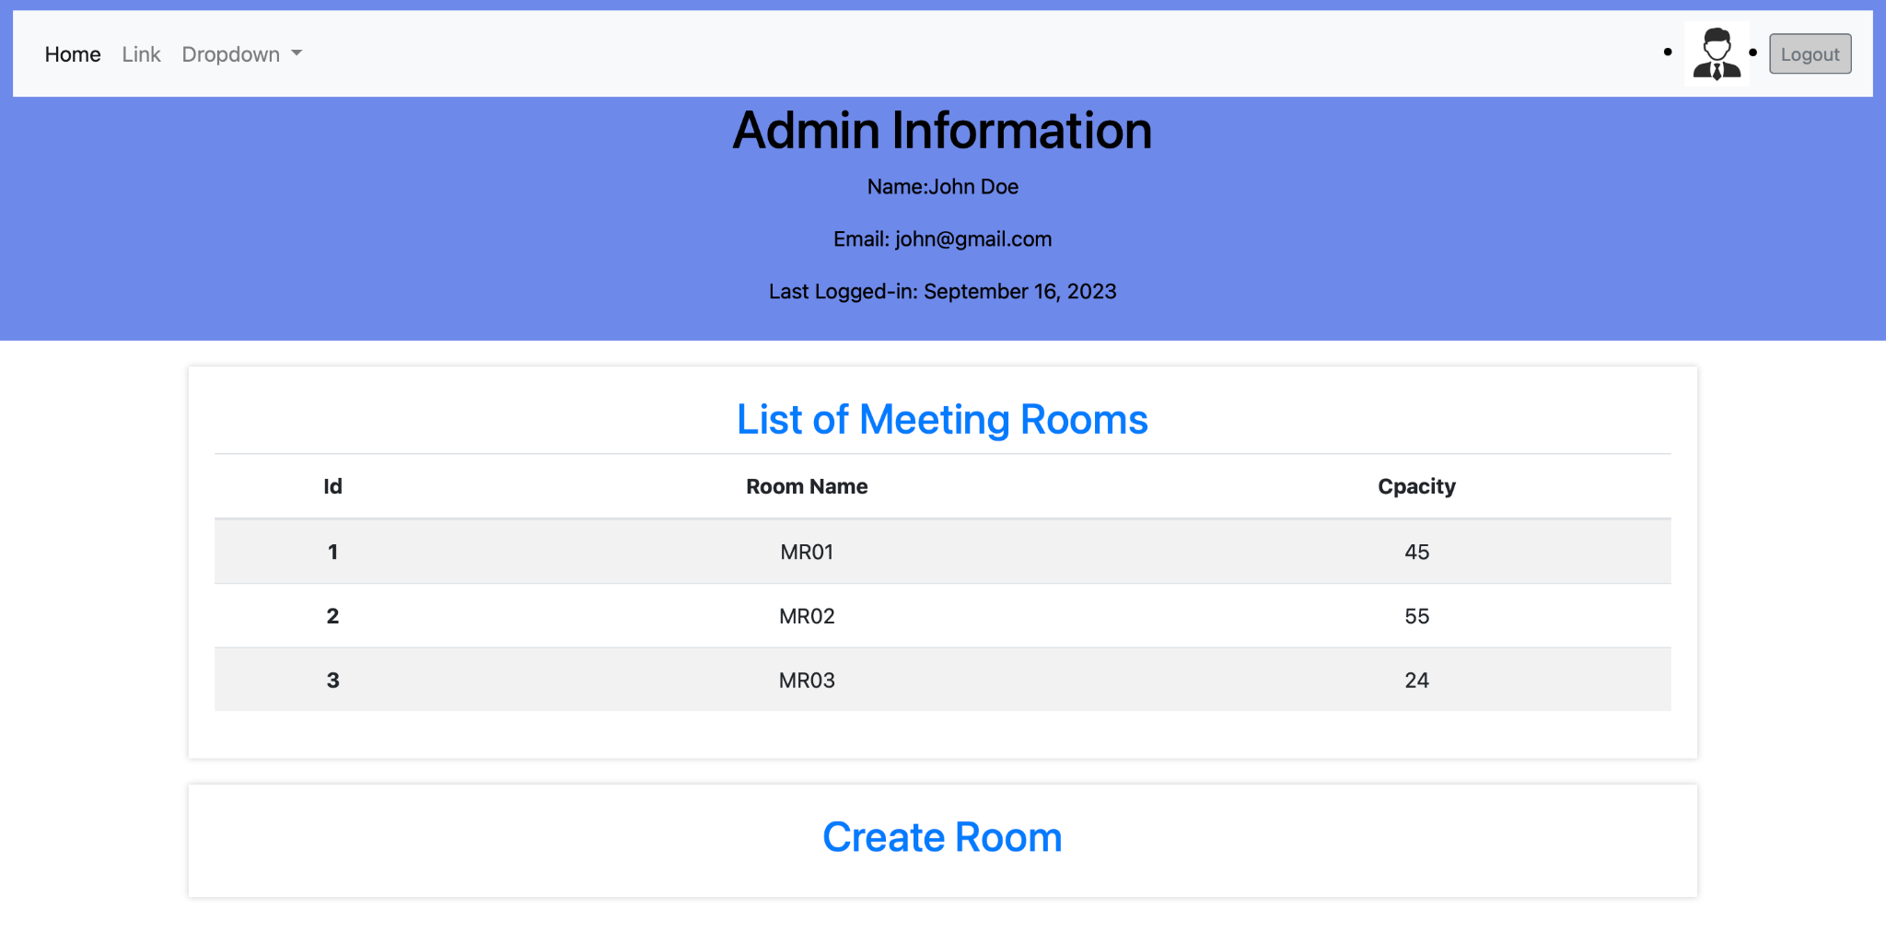

Slide 12
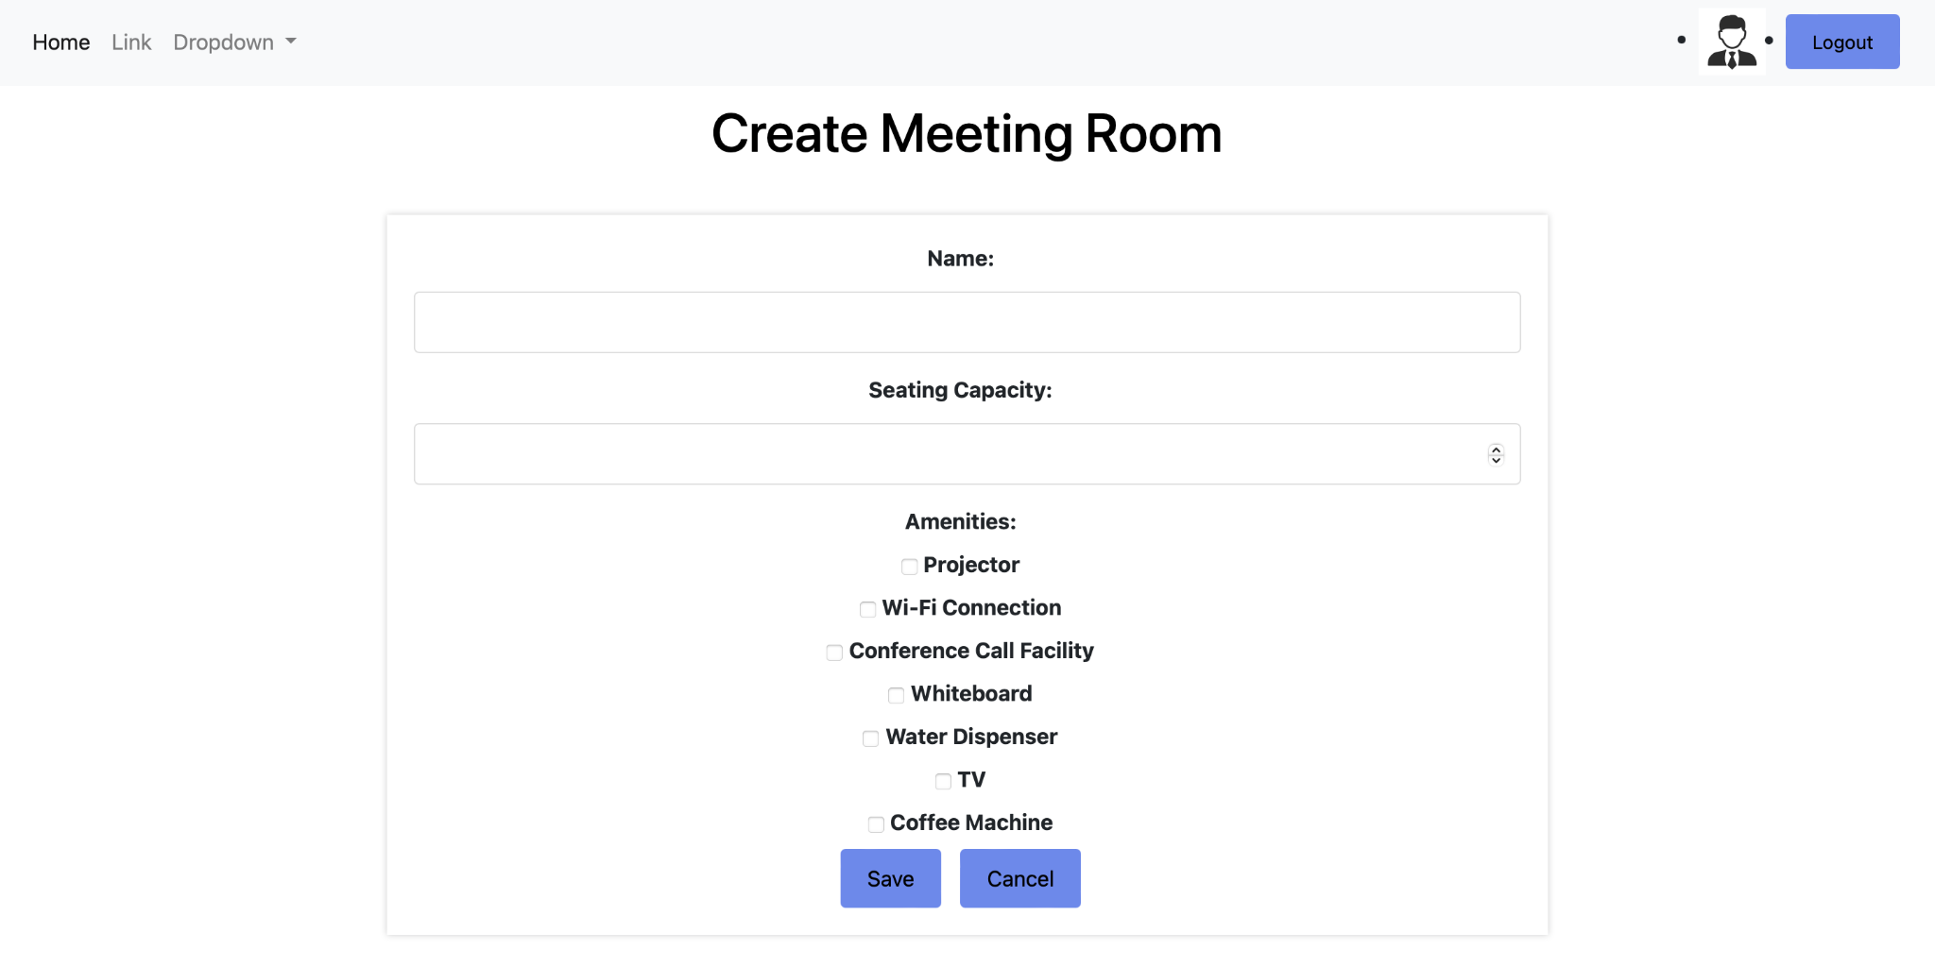

Slide 13
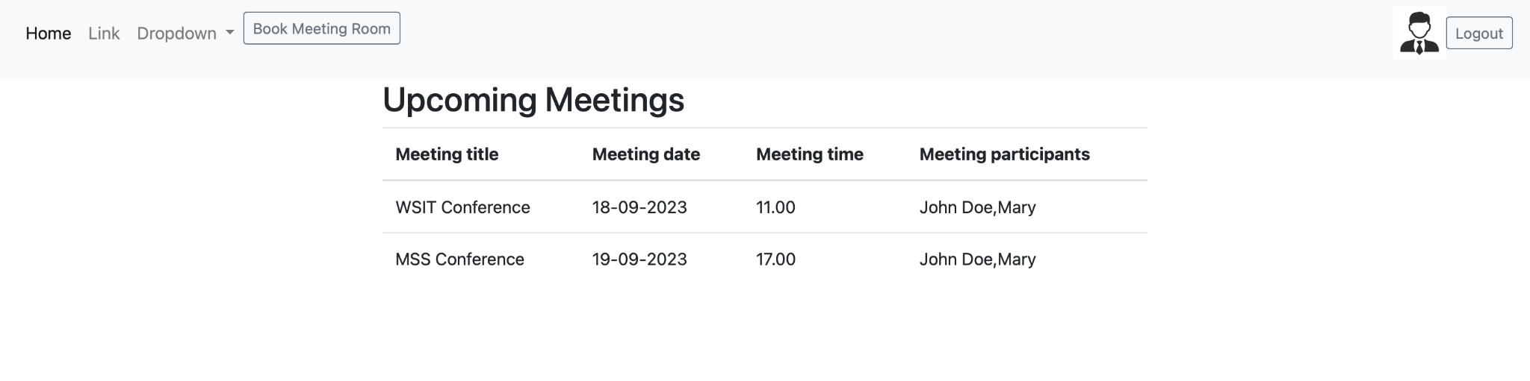

Slide 14
